Slide 1
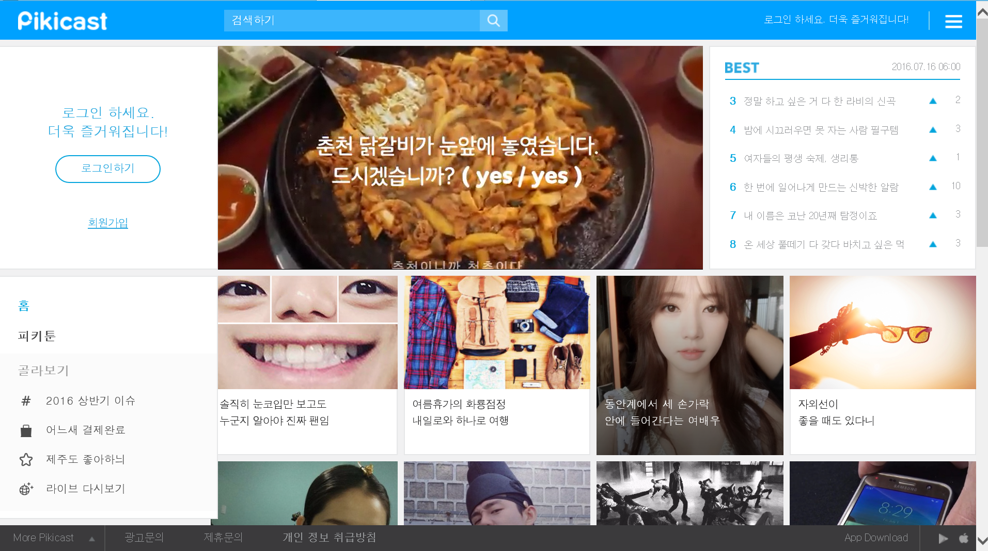
Head Search
Btn
Head
text
Head
menu
Head Search
text
Head Logo
Aside text
Aside Login btn
Aside regist btn
Main banner
미정…
Aside home
Category title
Contents_#
Contents list
Category_# 미정…
Footer menu

Slide 2
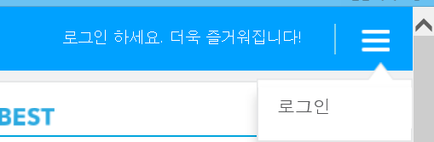
Head
text
Head
Push
Head
btn

Slide 3
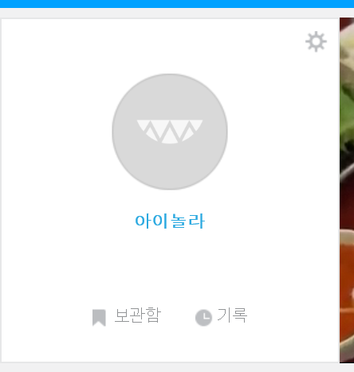
Aside profile
Aside profile modify
Aside profile name
Aside profile store
미정…
Aside profile recode
미정…

Slide 4
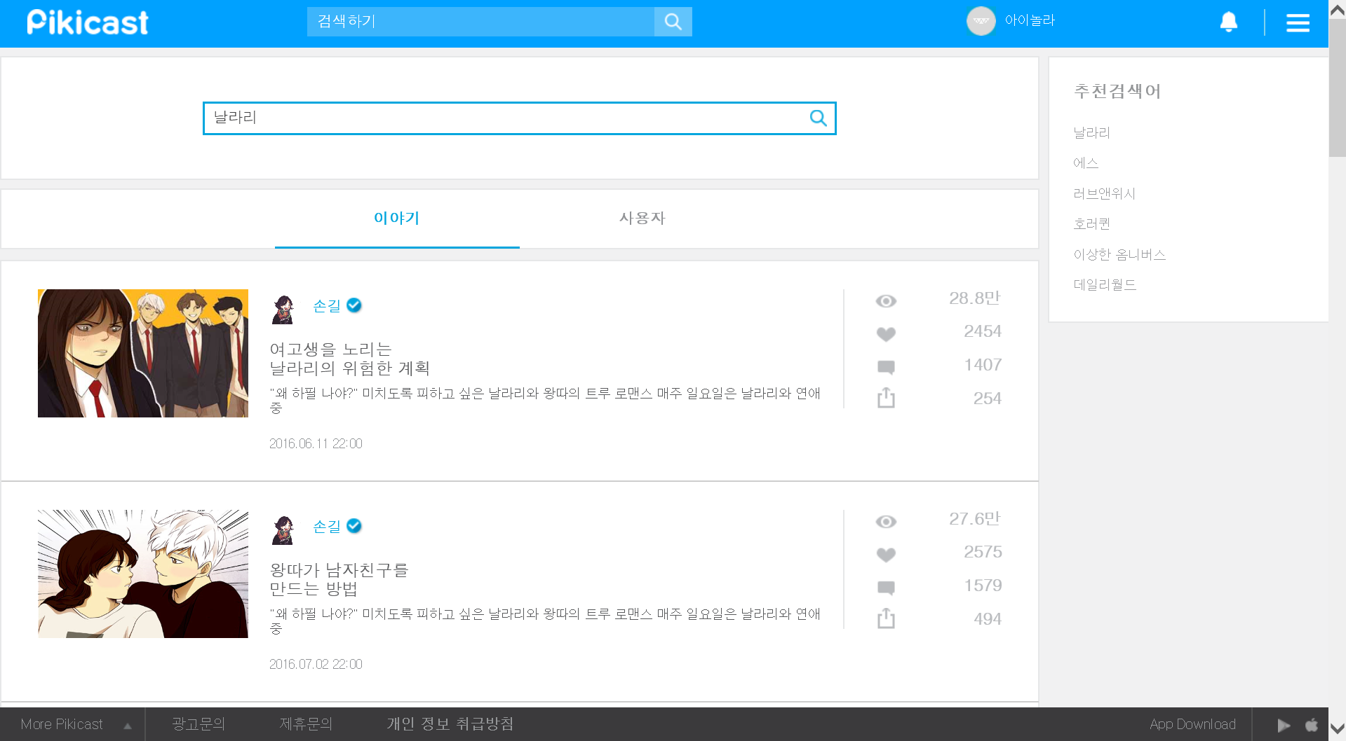
Search text
Search keyword
Search btn
Search user
미정…
Search contents

Slide 5
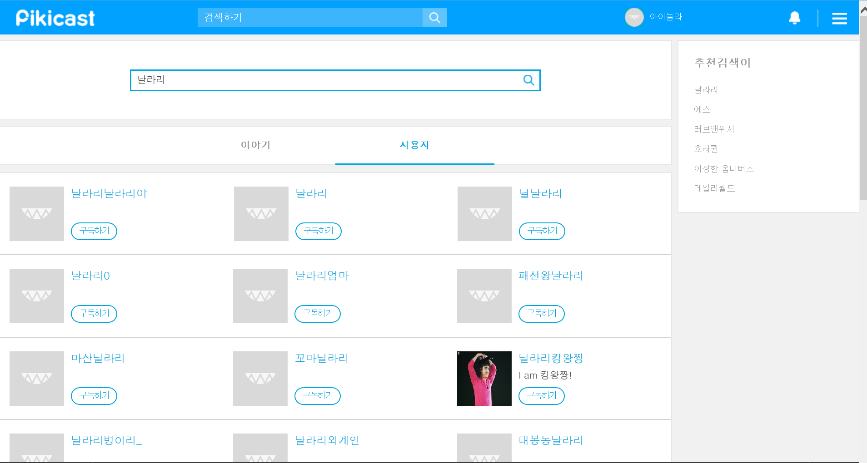
Search user#

Slide 6
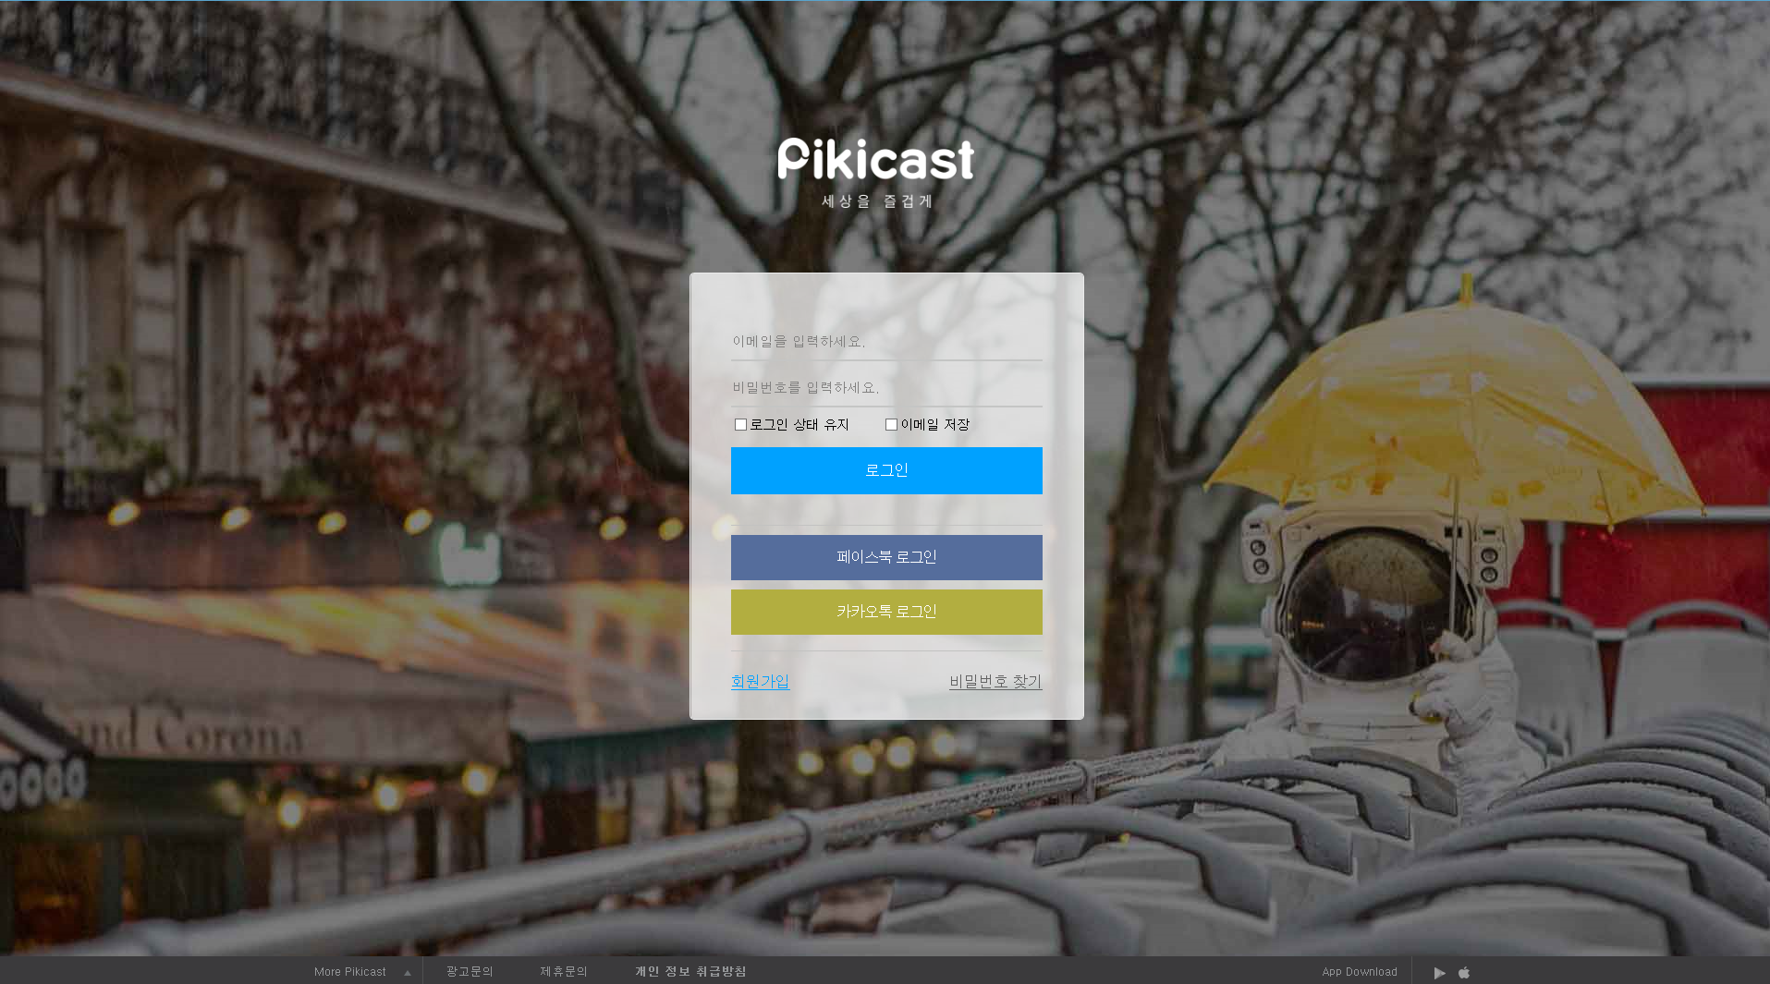
Login logo
Login email text
Login pw text
Login check
Login email save check
Login btn
Login fb btn
Login kakao btn
Login regist btn
Login pw search btn

Slide 7
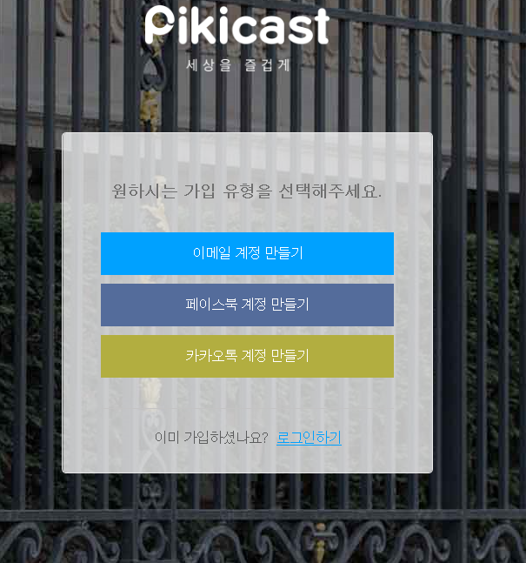
regist title
regist email add btn
regist fb add btn
regist kakao add btn
regist already text
Regist goLogin

Slide 8
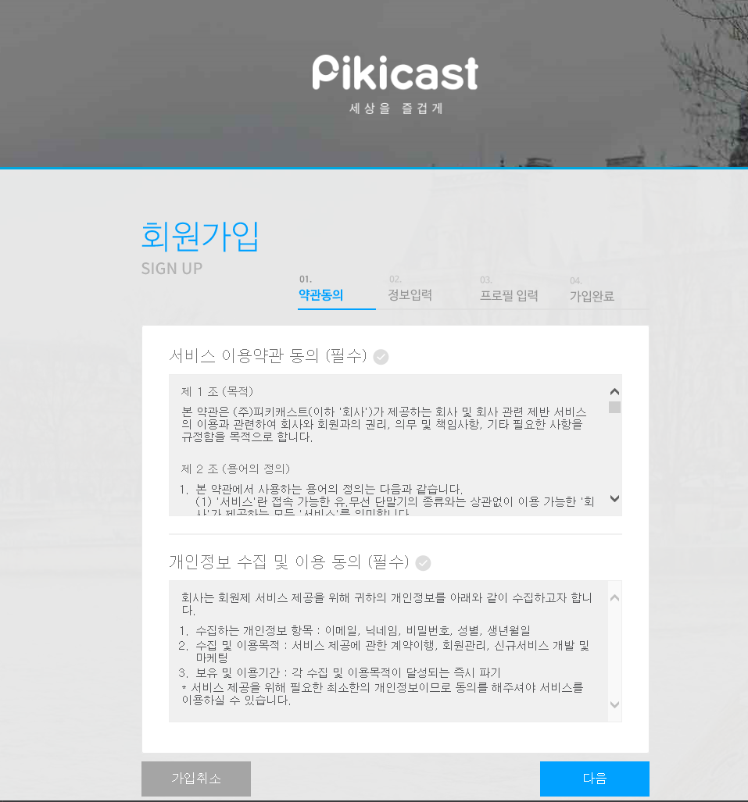
Regist state
Regist contents
Regist next
Regist previous

Slide 9
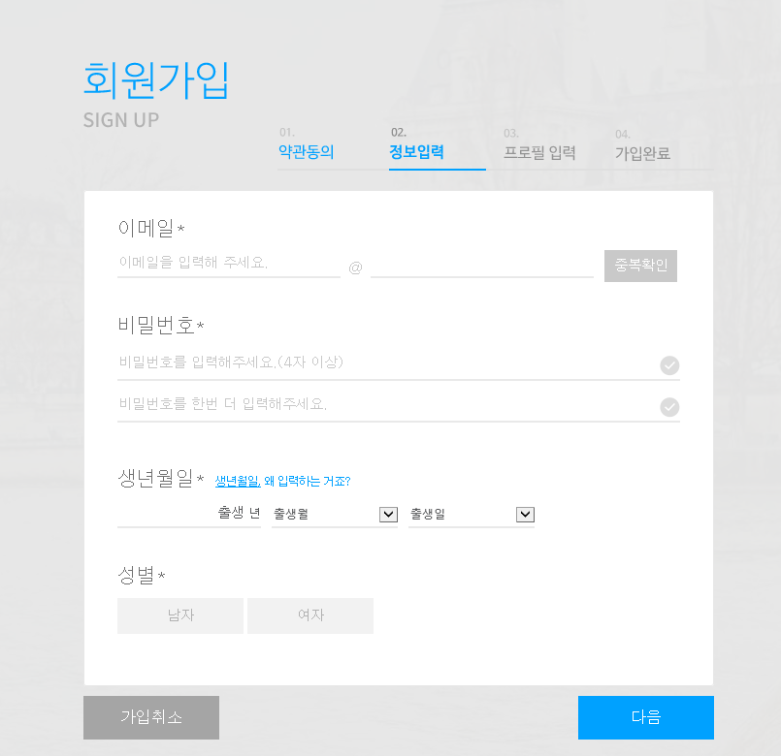
Regist email title
Regist email text
Regist email check btn
Regist pw title
Regist pw text
Regist pw confirm text
Regist birth title
Regist birth text
Regist sex title
Regist sex radiobtn

Slide 10
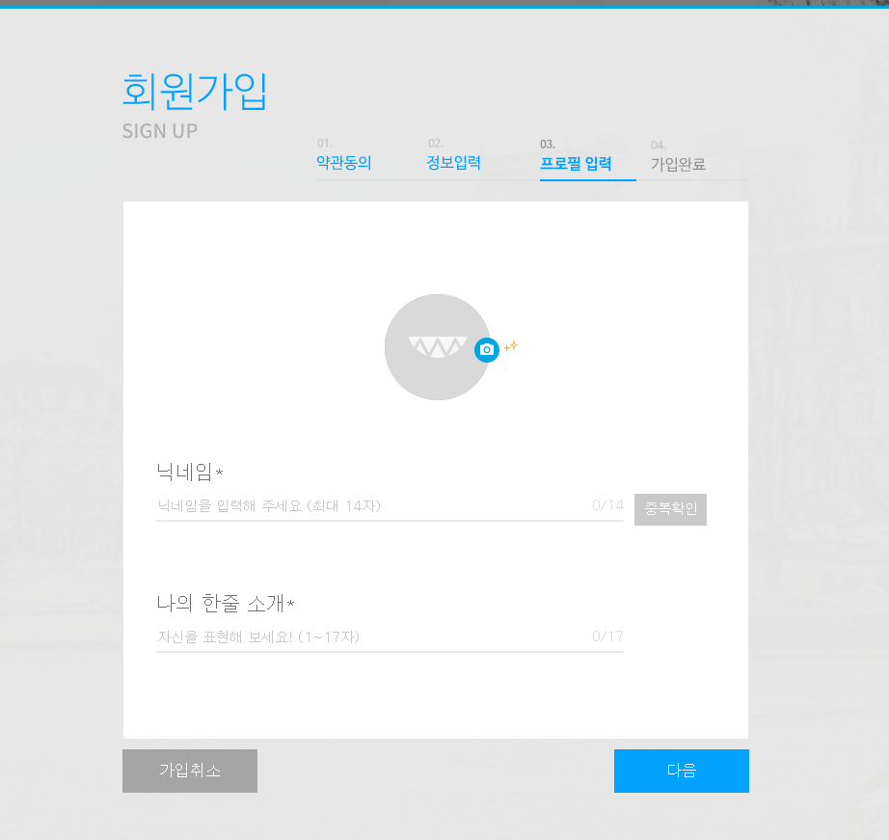
Regist profile image
Regist profile name title
Regist profile name text
Regist profile name check btn
Regist profile introduce title
Regist profile introduce text

Slide 11
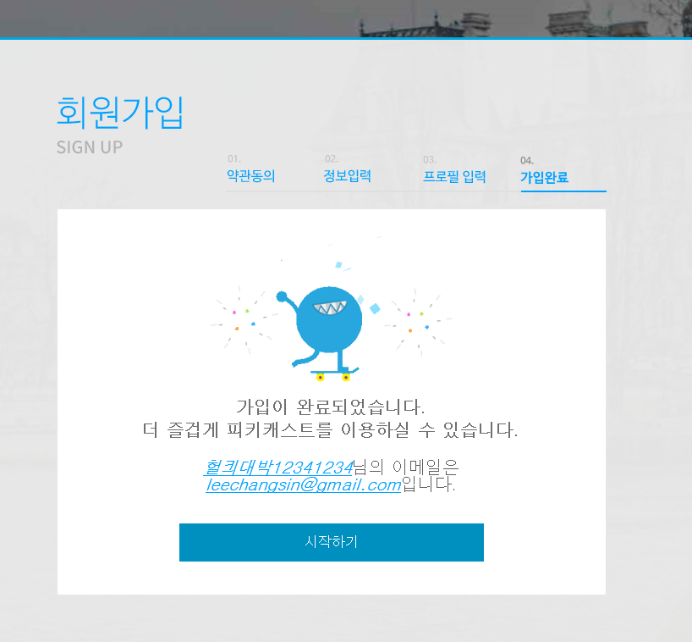
Regist profile name text
Regist email text
Regist goMain

Slide 12
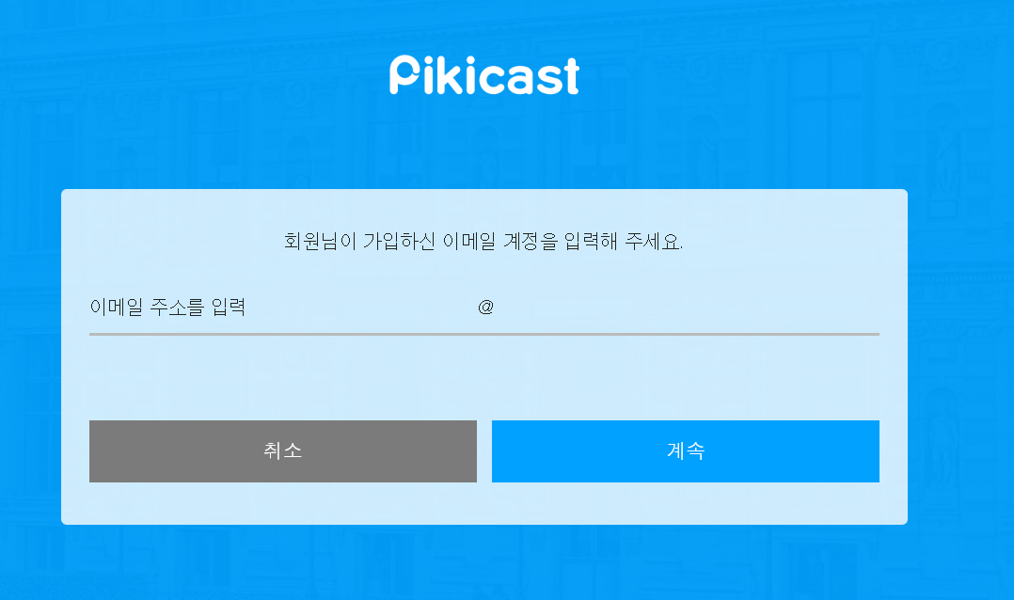
Login pw search logo
Login pw search title text
Login pw search email text
Login pw search goLogin
Login pw search next

Slide 13
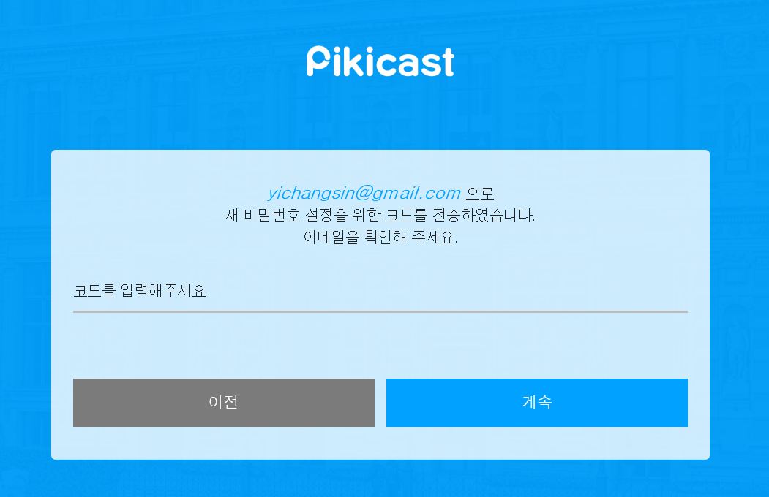
Login pw search title text
Login pw search code text

Slide 14
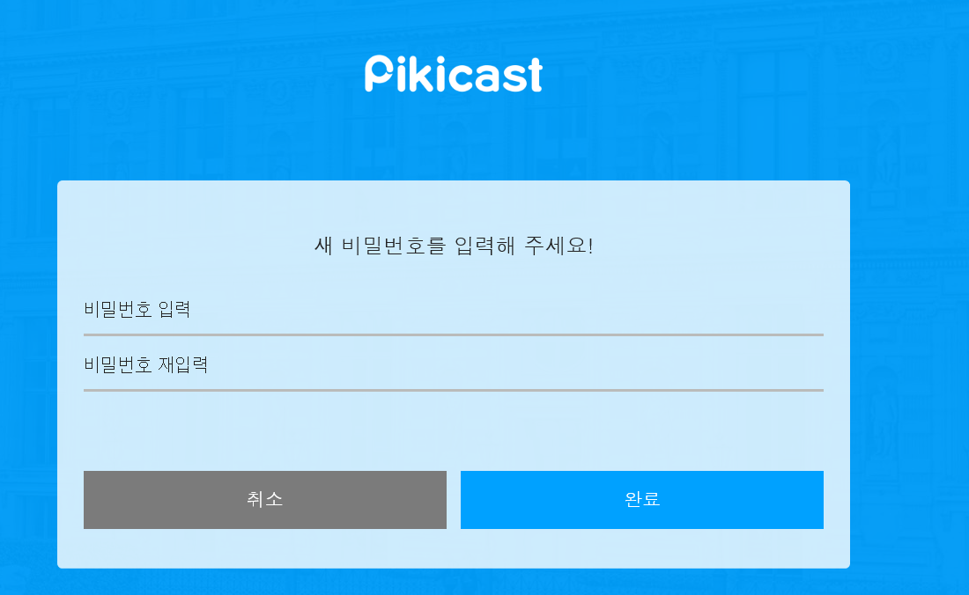
Login pw search title text
Login pw search pw text
Login pw search pw confirm text

